Slide 1
Going Beyond the Comfort Zone

Slide 2
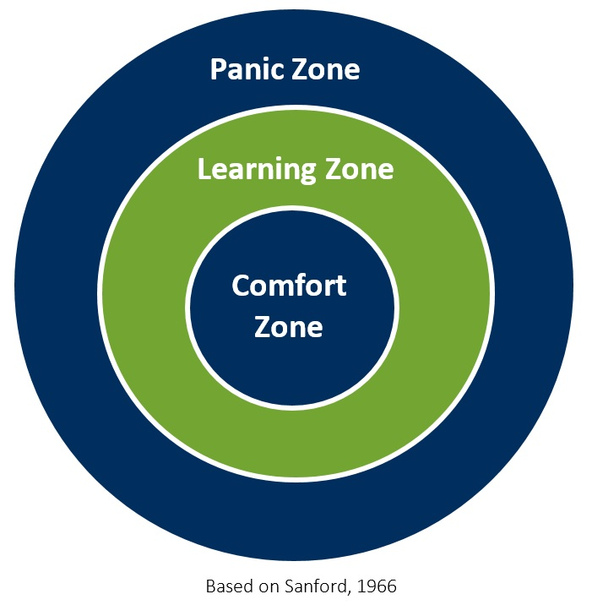
Sanford’s Theory Of Challenge And Support
Harvey, T. (2017, June 22). Getting beyond the comfort zone. True North Intercultural. https://www.truenorthintercultural.com/blog/getting-beyond-the-comfort-zone
Notes:
Facilitator notes: Introduce the theory of challenge and support.

Slide 3
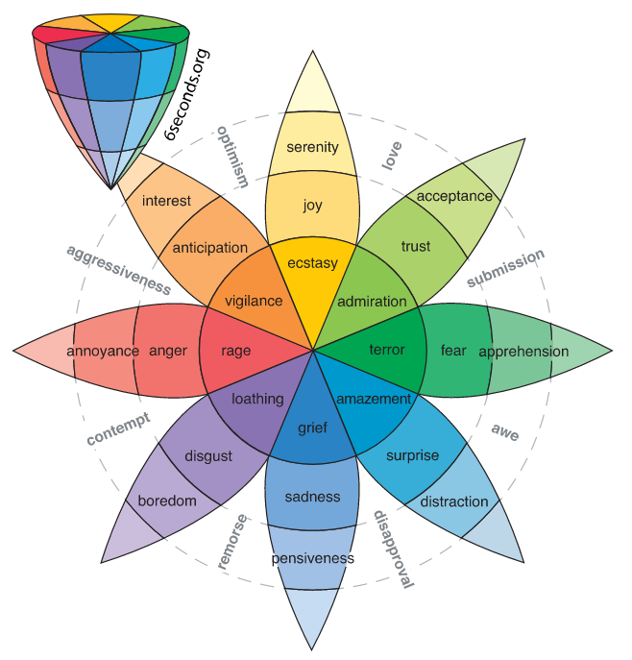
The Wheel of Emotions
Plutchik's wheel of emotions: Feelings wheel. Six Seconds. (2022, July 22). https://www.6seconds.org/2022/03/13/plutchik-wheel-emotions/
Notes:
Facilitator notes: Encourage students to use the Wheel of Emotions.

Slide 4
The Comfort Zone
Think of a time you experienced the comfort zone.
Describe the comfort zone as it relates to you.
What does the comfort zone feel like? Does it have a sensation?
What does the comfort zone look like? Does a color, shape, etc. come to mind when you think about the comfort zone?

Slide 5
The Comfort Zone
?
?
?
Comfort
?
?
?
?

Slide 6
The Panic Zone
Think of a time you experienced the panic zone.
What circumstances led to you landing in the panic zone?
Describe the panic zone as it relates to you.
What does the panic zone feel like? Does it have a sensation?
What does the panic zone look like? Does a color, shape, etc. come to mind when you think about the panic zone?

Slide 7
The Panic Zone
?
?
?
Panic
?
?
?
?

Slide 8
The Learning Zone
Think of a time you experienced the learning zone.
Describe the learning zone as it relates to you.
What does the learning zone feel like? Does it have a sensation?
What feelings came before landing in the learning zone?
What feelings followed?
What does the learning zone look like? Does a color, shape, etc. come to mind when you think about learning?

Slide 9
The Learning Zone
?
?
?
Learning
?
?
?
?

Slide 10
Debrief
Why did you choose your particular image?
Why might different images be chosen for different contexts?
When you find yourself in a new and challenging environment, what will you do to coach yourself out of your comfort zone?
For those of you who resonate with the panic zone, when you find yourself there, what might you do to coach yourself into the learning zone? What might you need in those situations?
What will help you remember to reference this image and quote when you find yourself in the comfort and panic zones?

